Slide 1


Materials for the Data Analytics project:
The day has come!!!
Revenue metrics
(GOIT Educational Project
by Bartko Andrii)

Slide 2



ЗМІСТ
-
Description of project “Revenue metrics”
-
Technology stack
-
Challenges and solutions
-
Dashboard “REVENUE METRICS”
-
Conclusions
-
Insights
-
Recommendations
-
Thank you for your attention.

Slide 3

Description of project “Revenue metrics”
Create a dashboard for analyzing cash inflows on a project. With its help, (imaginary) product managers will track the dynamics of changes in cash inflows and perform a top-level analysis of the factors of these changes. Calculate the necessary economic metrics and create an interactive dashboard in Tableau Public.

Slide 4
Technology stack
DB Beaver - for working with the database, data unloading.
Postgre SQL - aggregation, metric calculation.
Tableau Public - visualization, dashboard.

Slide 5
Challenges and solutions
📉 Problem: incomplete monthly data → solved by generating a calendar in SQL.
🔄 Problem: defining churn → implemented using LAG() and CASE.
🧩 Problem: merging user attributes → done using LEFT JOIN on the games_paid_users table.

Slide 6
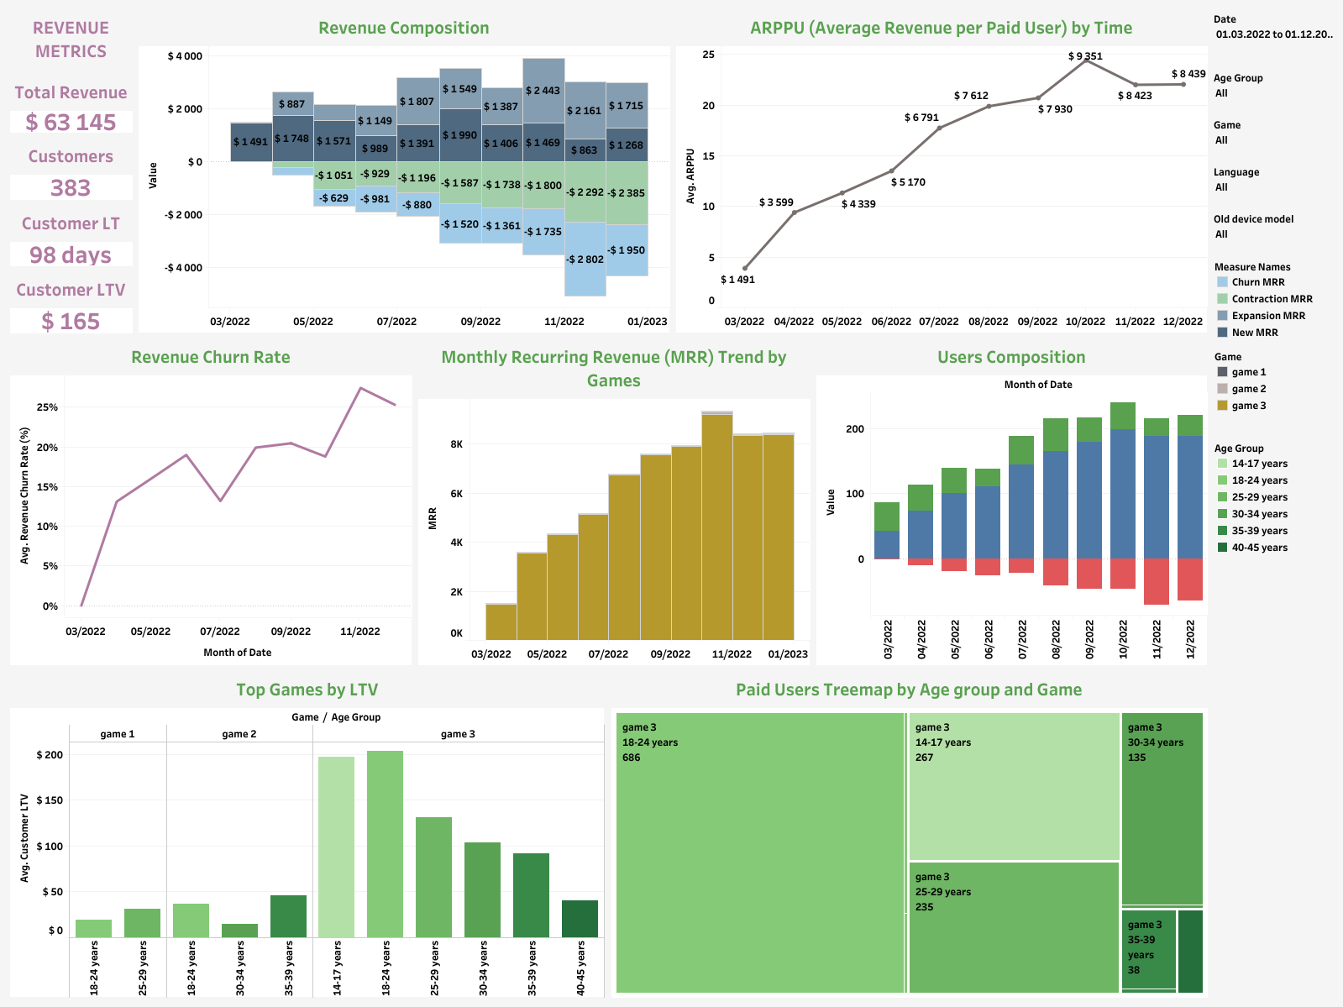
REVENUE METRICS

Slide 7
Conclusions
The dashboard shows a steady growth in key metrics - revenue and number of paid users during 2022. During the analyzed period, total revenue amounted to $63,145, generated by 383 paid users.
The main increase was provided by recurring payments, not new users, which indicates effective monetization. The average user life cycle is 98 days, the average LTV is $165, which is a stable result for a product from the gaming sector. Overall, the business shows healthy dynamics with a controlled level of customer churn. The positive trend of Monthly Recurring Revenue (MRR) - confirms the healthy development of the product. Revenue Churn Rate fluctuates, but remains within controlled limits (<25%), which is an acceptable level for the gaming industry.

Slide 8
Insights
Users aged 18-24 generate the highest share of revenue, but 14-17 year olds have the highest LTV - they are the most profitable when retained.
Expansion MRR consistently exceeds Contraction MRR, meaning the product generates net growth even in the presence of churn.
The largest user churn was observed in September 2022 - possibly due to product updates or external factors.
Gamers aged 25-34 show the longest lifecycle (LT > 90 days), so this is the most stable audience with high loyalty.
The younger audience provides volume, the older - quality of payments, which opens up the potential for segmented monetization.
Game 3 - has the largest number of paying users and high LTV among different age groups.

Slide 9
Recommendations
Focus on retaining younger users (14-24 years old), who have high LTV potential, through bonuses, personalized promotions and social mechanics.
Optimize the monetization model for stable players (25-34 years old), through personalized offers or subscriptions.
Analyze the increase in churn rate at the end of the year - seasonal retention campaigns or UX improvements may be needed.
Use the positive dynamics of Expansion MRR as a basis for forecasting growth and setting targets for the next period.
Focus marketing on “Game 3” - as the main source of income and the best indicator of retention across all age groups.

Slide 10

Together we gnawed at this granite of science until it turned into a diamond.
Thank you to the academy, mentors, managers, colleagues, and everyone involved in the project for an interesting start to the journey in Data Analytics.

